Slide 1


Crypto vs
the Market
Dan McQueen
Jason Buckholt
Majid Kouki
Tracy Emory

Slide 2
Project Description
Bitcoin investing vs S&P 500
Does BTC beat the market holding long-term?
How do the results differ when a basic swing trading strategy is implemented?

Slide 3
Libraries
Pandas
Pandas TA
Voila
Alpaca Trade API
PyViz
dotenv
MCForecastTools

Slide 4
Datasets
SPY - Alpaca
BTC - Coinbase Exchange

Slide 5
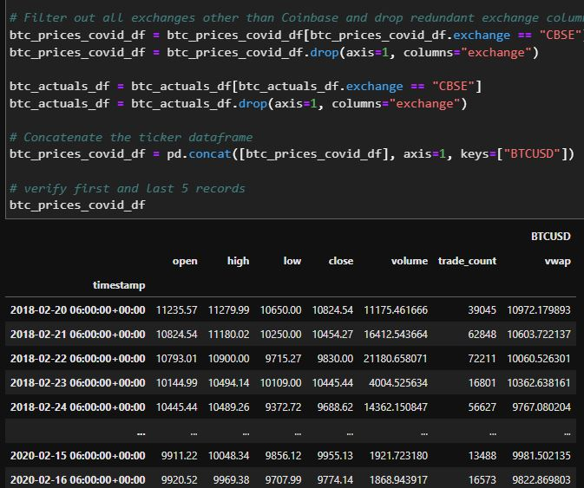
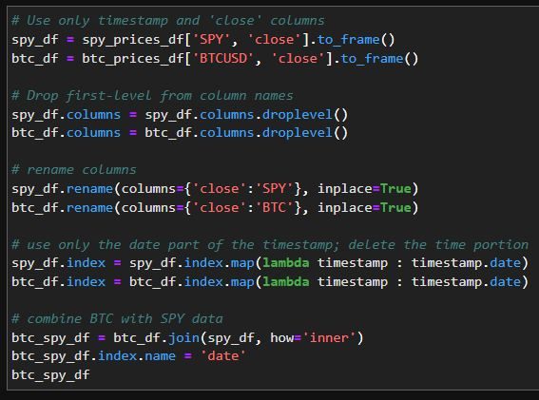
BTC vs SPY
Collecting Data

Slide 6
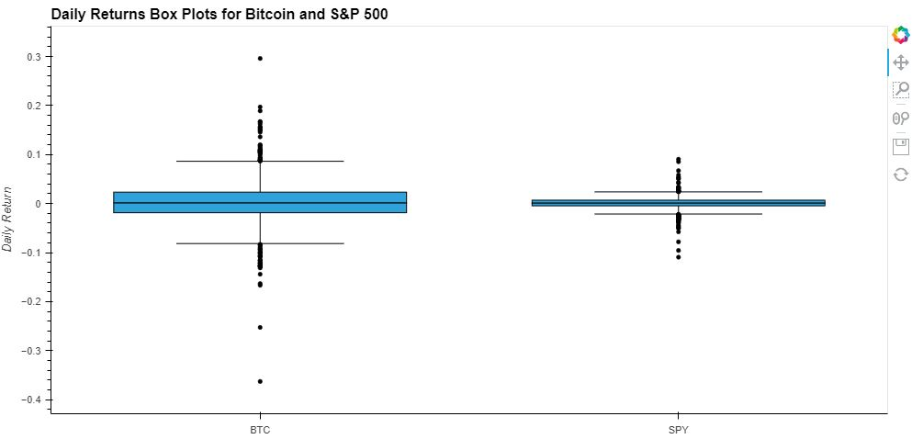
BTC vs SPY
Holding Long-Term
SPY BTC
Volatility
0.219753 0.751422
Sharp Ratio
0.484030 0.739624

Slide 7
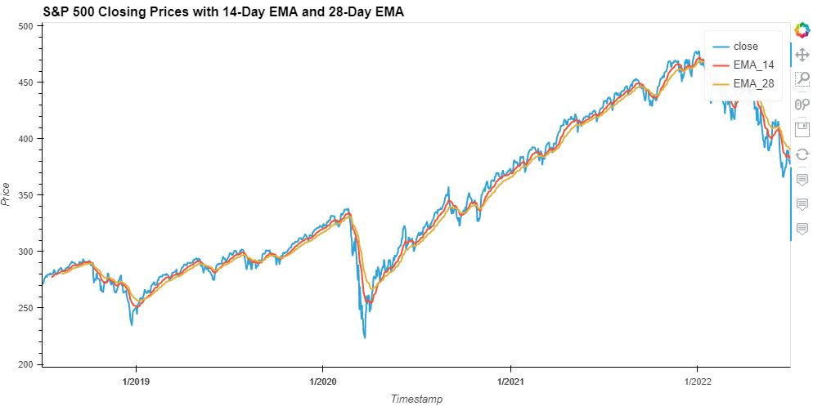
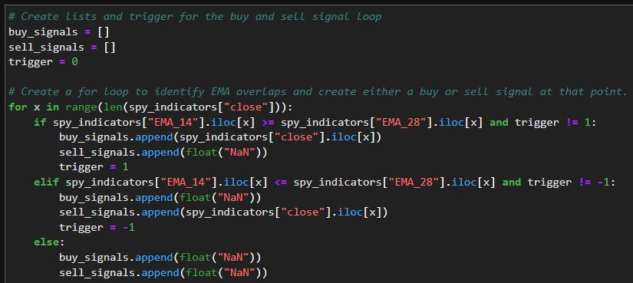
BTC vs SPY
Swing Trading

Slide 8
BTC vs SPY
Swing Trading

Slide 9
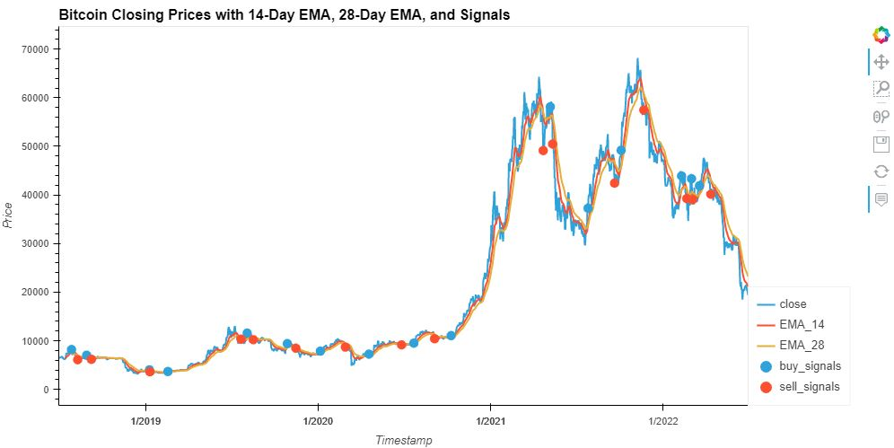
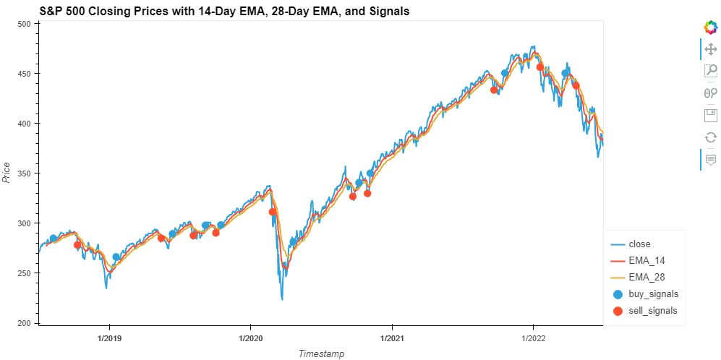
BTC vs SPY
Swing Trading
Long-Term Holding ​
​
$13067.58 in profits per coin​
​
14-Day & 28-Day EMA Trading Strategy​
​
$37795.01 in profits per coin​
​
Trading resulted in 189.23% more profits over long-term holding
Long-Term Holding
$109.38 in profits per share
14-Day & 28-Day EMA Trading Strategy
$126.94 in profits per share
Trading resulted in 16.05% more profits over long-term holding

Slide 10
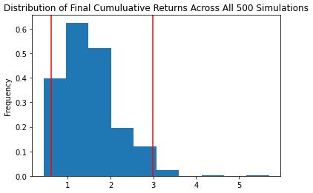
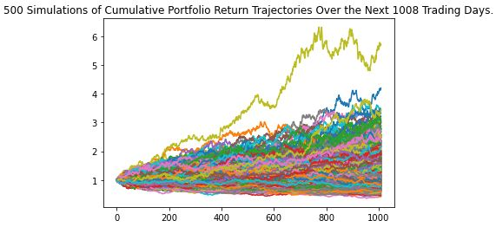
Monte Carlo Simulation
4 Years
500 Simulations
SPY

Slide 11
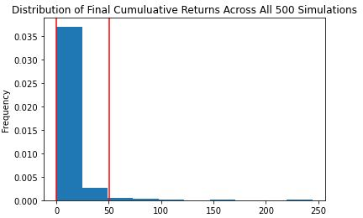
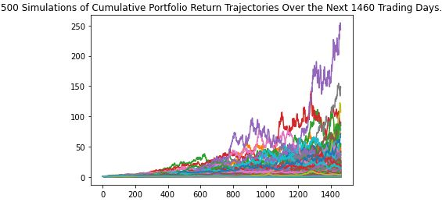
Monte Carlo Simulation
4 Years
500 Simulations
BTC

Slide 12
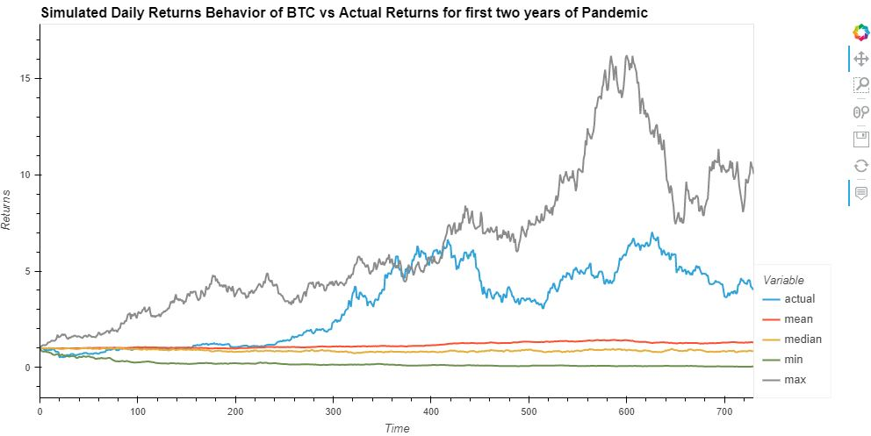
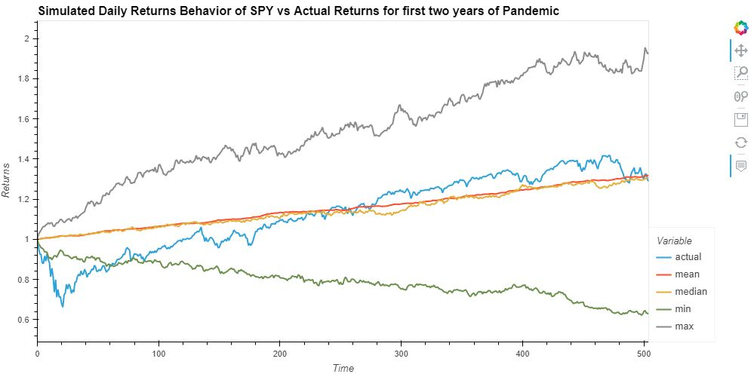
Monte Carlo Simulation
Pandemic Results

Slide 13
01
Overall Analysis of Results
Closing Notes
02
Long-Term Holding vs Swing Trading
03
Pre-Pandemic Comparisons

Slide 14
01
Future Additions
Project Expansion
02
Changes with Current Code
03
Problems with Monte Carlo Simulations
pandemic comparisons

